Slide 1

Welcome to GEOG 286 & 386 PYTHON PROGRAMMING
Instructor: Yanan Wu
TA: Shradha Birdika

Slide 2
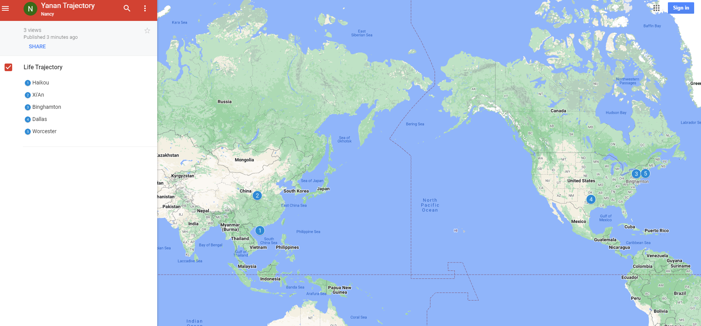
Yanan Wu – Visiting Assistant Professor
Education & Experience

Slide 3






Teaching
Python Programming
Spatial Database
Intermediate Statistics
Manipulating Spatial Data
Web Mapping
Processing Raster
Data Analysis
Creating Custom Tool
Data Visualization
…
Geodatabase
SQL
Proximity Analysis
Geometry processing
Raster processing
PostSQL with python
…
Bivariate regression
Logistics regression
PCA
GWR
Spatial Autocorrelation
…

Slide 4

PYTHON PROGRAMMING
COURSE ASSISTANT
SHRADHA BIRDIKA
OFFICE HOURS:
WEDNESDAY
2:00 - 4:00 PM
JF 123
(ADP MA GIS LAB)

Slide 5

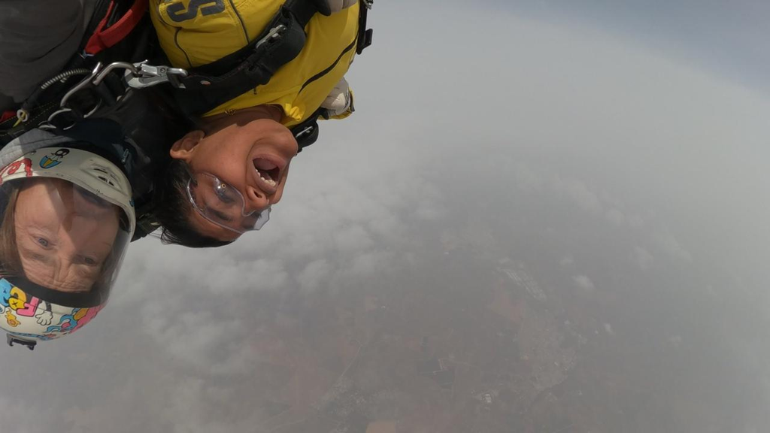


Education
Clark University
Master of Science;
Geographic Information Science (MS-GIS)
Expected Graduation: May 2025
Bachelor of Arts;
Geography major, GIS concentration, Economics minor
Graduated Summa Cum Laude: May 2024
Hobbies
Traveling
Adventure Sports
Astronomy

Slide 6
How about you?
Your background (e.g., name, major, where you come from)
What is your funniest thing that happened during your winter break?
What relevant experience do you have with python?
What are your expectations for this course?

Slide 7
Course Format
Lectures: Jonas Clark Hall JC103 (Instructor & TA)
Monday: 9:00 – 10:15 AM
Thursday: 4:15 – 5:30 AM
Labs: Jonas Clark Hall JC103 (TA)
Friday: 9:00 – 10:15 AM
Instructor Office Hours: Tuesday & Thursday: 1: 30 – 2:30 PM (or by appointment)
Instructor Office Location: Geography Main Office, Jeff 220

Slide 8

Course Schedule
Week 8 (MAR 3)
Spring Break
*schedule for other weeks please see syllabus

Slide 9
Course Schedule
Week 9 (MAR 10)
Midterm (Take Home Exam)
Week 11 (MAR 24)
AAG Conference
Week 15 & 16 (APR 14)
Final project
*schedule for other weeks please see syllabus

Slide 10
Course Requirements
Labs: 9 in total.
For any graded assignment, if the you do not agree with the grade received, the
instructor must be notified within one week after the assignment is graded.
One midterm exam & One Final Project (Oral presentation and paper report)

Slide 11
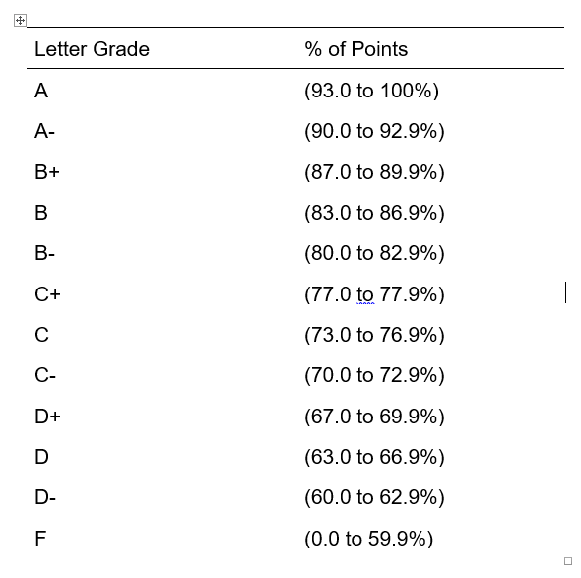
Grade
9 labs (70%): 700 points (70%)
Midterm exam (15%): 150 points (15%)
Final Project (15%) 150 points (15%)
1000 points total (100%)

Slide 12

GIS HELP DESK
NEW SPRING 2025 HOURS:
Need help with GIS? Can't make it to visit your professor or TA for office hours? Stop by our GIS Help Desk in the Jefferson Tower (6th floor), or in Jefferson 220A (2nd floor Jefferson building, Geog Main office) on Wednesdays, and visit one of our Help Desk Assistants!
MONDAYS
TUESDAYS
WEDNESDAYS @ JF220A
THURSDAYS
FRIDAYS
SASHA 9 AM - 11 AM
SASHA 9 AM - 12 PM
SASHA 9 AM - 12 PM
WYNNIE 2 PM - 5 PM
WYNNIE 2 PM - 5 PM
WYNNIE 3 PM - 5 PM
GIS Help Desk hours follow a University schedule. If the University is closed from remote/online operations for any reason, the GIS Help Desk may also be unavailable. GIS Help Desk Assistants operate on a first-come, first-serve drop-in basis. Contact Marjorie Miller (marmiller@clarku.edu) with any questions, or call the Geography Main Office at 508-793-7336 for more information. The GIS Help Desk is sponsored by the Graduate School of Geography at Clark University.

Slide 13
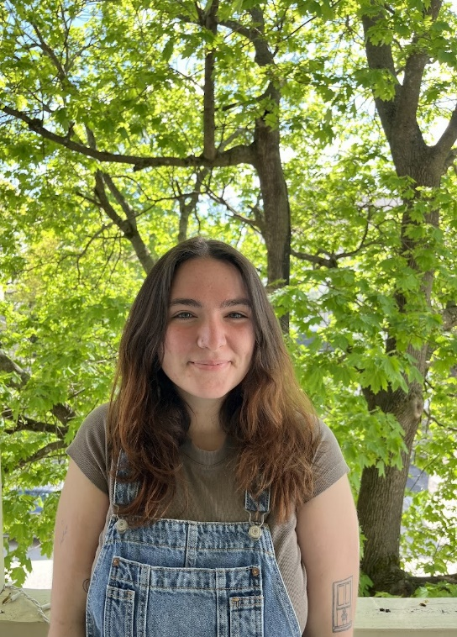

Spring 2025 hours
GIS Help Desk
Please contact either of our GIS Help Desk Assistants during their specified hours for more information.
SASHA GANNON| GEOG ’24 MS-GIS ‘25
WYNNIE GROSS| GEOG ’24 MS-GIS ‘25
MONDAYS 9AM – 11AM
TUESDAYS 9AM – 12PM WEDNESDAYS* 9AM –12PM
WEDNESDAYS*
3PM – 5PM
THURSDAYS
2PM – 5PM
FRIDAYS
3PM – 5PM
Help Desk hours follow a University schedule. If the University is closed (or if the Geography office is closed), the GIS Help Desk will be unavailable. Hours may be limited or extended during midterms/final exams. Any changes will be announced or posted on the Clark University Geography Facebook page. Appointments operate on a first-come, first-serve drop-in basis unless otherwise scheduled.
508.793.7336 | Jefferson Tower, 6th Floor; *Wednesdays are in Jefferson 220A, Geog Main Office, Jefferson Building, 2nd Floor*

Slide 14
Textbook
Free Online learning source
Ujaval Gandhi (2024). Python Foundation for Spatial Analysis. https://courses.spatialthoughts.com/python-foundation.html
Dave Whipp (2023). Geo-Python 2023. https://geo-python-site.readthedocs.io
Qiusheng Wu (2023). Earth Engine and Geemap: Geospatial Data Science with Python. https://book.geemap.org
Non-open Source Textbook
Eric Pimpler, Programming ArcGIS Pro with Python, 2nd Edition

Slide 15
Emailing the TA and Instructor
Use “geog-Python” as the subject of the email

Slide 16




COURSE WEBSITEs ON GITHUB
Intermediate Statistics
Spatial Database
Python Programming
Web Mapping

Slide 17
Why taking this class?
Our focus is on problem solving
Two module together
Exercise/project-oriented, not theory-oriented
We take care of what and how but not why!

Slide 18
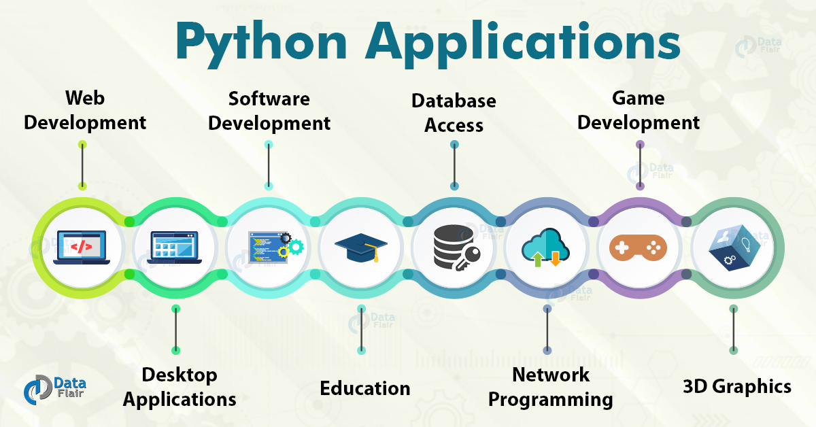
Overview

Slide 19
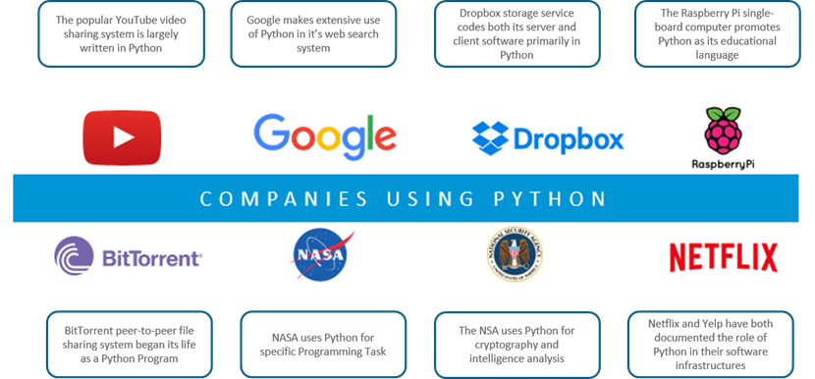

Slide 20
Why Programming?
Customize applications and tools
Reduce repetitive work
Access more functionality
Add new functionality / Extend GIS functionality into non-GIS applications

Slide 21
Why Python?
An open-source language
Packages, libraries, functions, resources…ALL FREE (Our textbooks have free versions as well)
GREAT documentation!
https://docs.python.org/3/
ArcPy (Not usable separately)
PyQGIS
Cross-platform

Slide 22
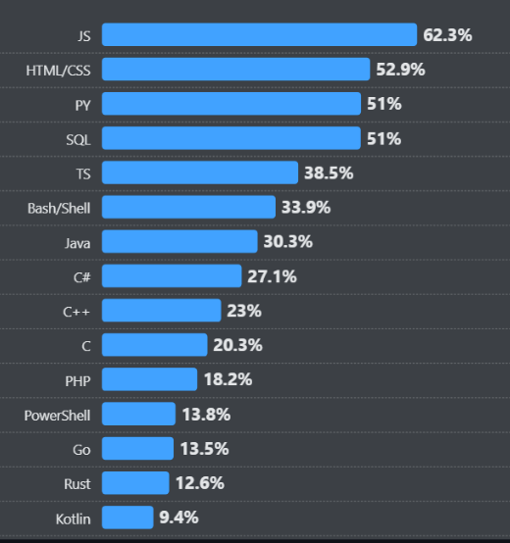
Source: survey.stackoverflow.co

Slide 23
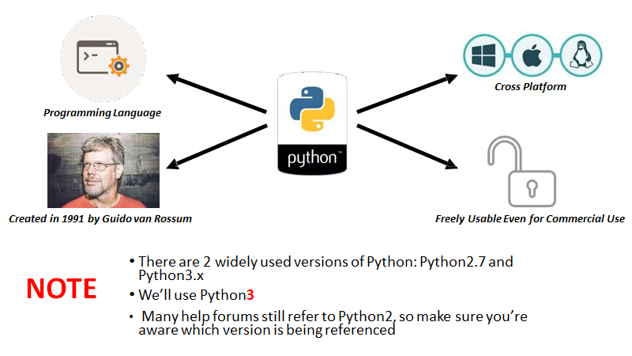

Slide 24
Python Version
Python versions
2.x up to 2.7, 3.x (currently 3.12.x)
Python 2.x is legacy, Python 3.x is the present and future of the language
3.x may have compatibility issue with other software
Be careful when you download different versions
Especially when you install external libraries and packages

Slide 25
One way to know the version of Python!
Command Prompt
Why this is important?
Different libraries
Functionality
Version reliability

Slide 26
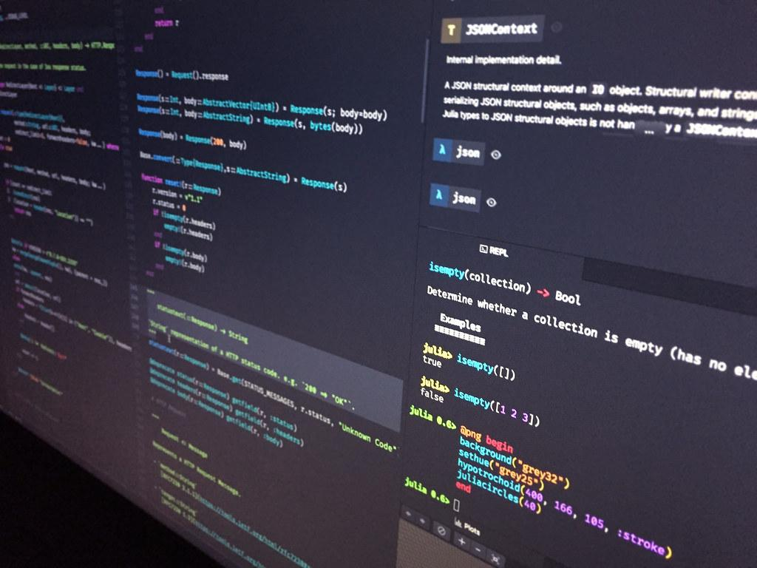
What if I do not want to deal with the command prompt?

Slide 27
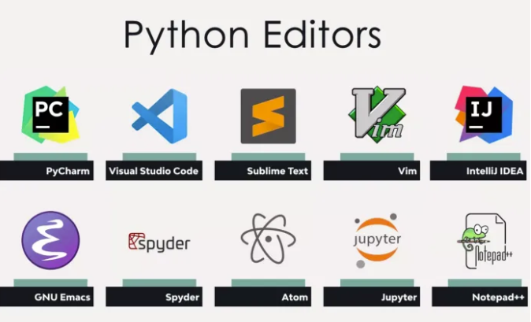
You can have both ways of writing python in most of text editors!
Source

Slide 28
Visual Studio Code (VS code)
Developed by Microsoft for Windows, Linux, macOS
Used with a variety of programming languages: Python, Java, JavaScript, C++
Various features: debugging, syntax highlighting, intelligent code completion, version control with Git
Download Link

Slide 29

How Do I Program In Python?
ANACONDA
An open-source Python distribution platform (Download link)
Manages packages and working environments

Slide 30

Google Colab
What we covered so far was based on the fact that you want to use your own computer as a Python interpreter!
What if I want to practice programming on the web?
Google Colab
Github (Not recommended for now!)

Slide 31
While Using Colab
A folder will be created automatically in your Google Drive

Slide 32
Python Fundamental
Python
Condition Statement
If, elif, else
Loops
For, while
Functions
Define, Return, Lambda
Data Structure
List, Tuples, Dictionaries, Strings
Modules and Packages
Import, Virtual Environment

Slide 33






Non-spatial data processing: Pandas
DataFrame Creation
Data Inspection
Data Selection
Data Cleaning
Data Manipulation

Slide 34
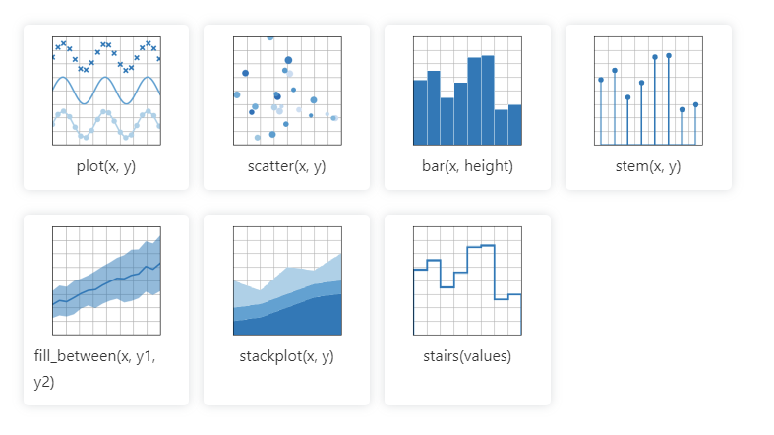
Data Visualization: Matplotlib
Matplotlib cheatsheets and handouts

Slide 35
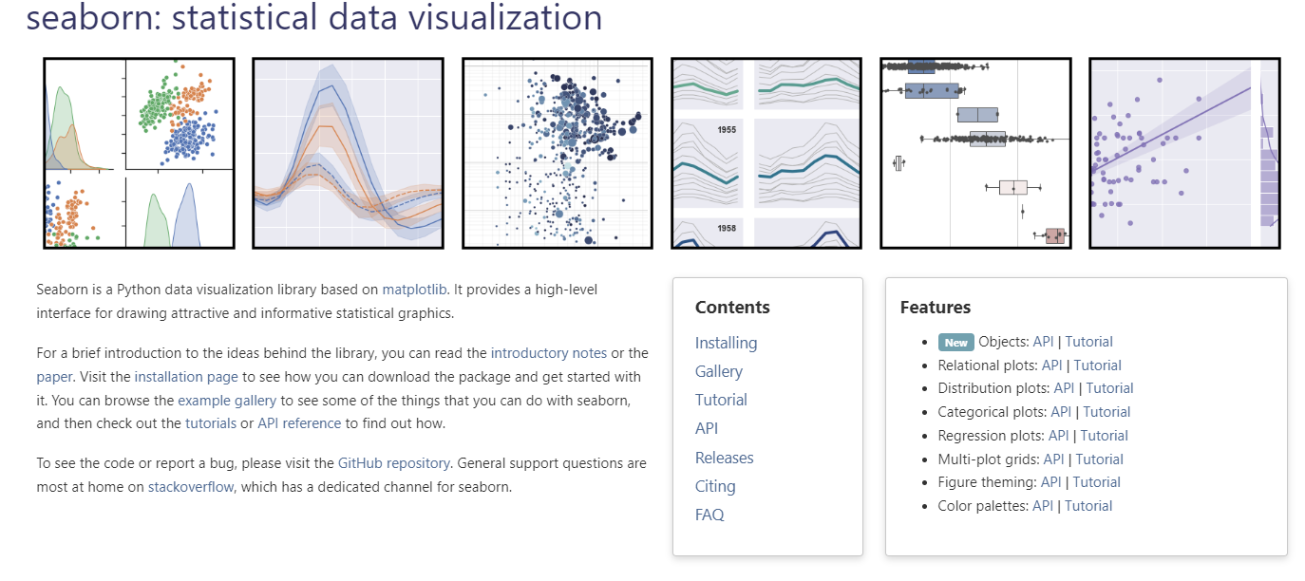
Data Visualization: seaborn
Seaborn cheatsheets and handouts

Slide 36
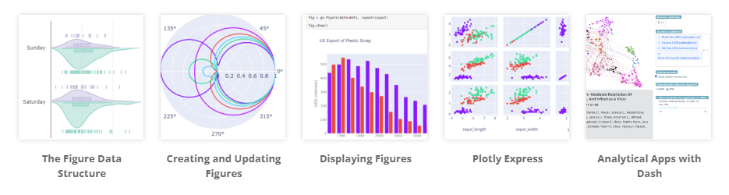
Data Visualization: plotly

Slide 37
Difference among three
plotly
seaborn
matplotlib
matplotlib: Low-level library
seaborn: built on top of matplotlib
plotly: focused on interactive plots

Slide 38
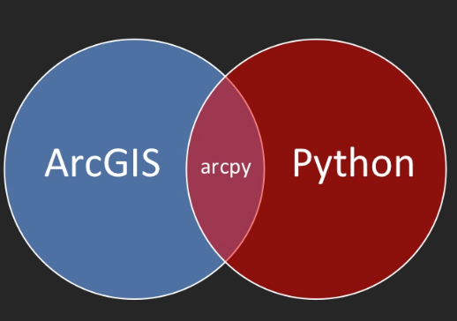
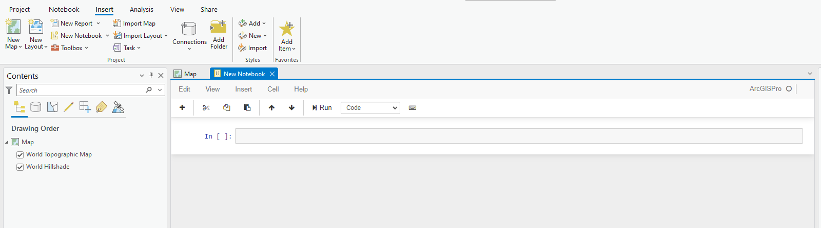

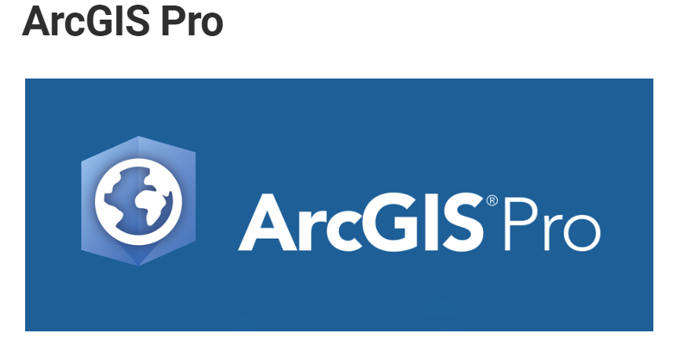
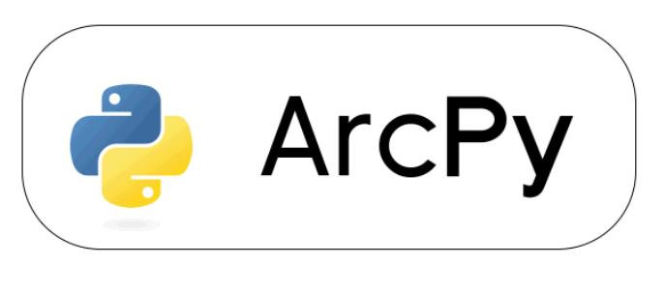
Geoprocessing - Arcpy
Integration with ArcGIS Pro
Scripting & Automation
Access to Geoprocessing Tools
Interact with other Esri products

Slide 39
Web maps using the ArcGIS API for Python
Esri User Document
Esri official Repo on GitHub

Slide 40
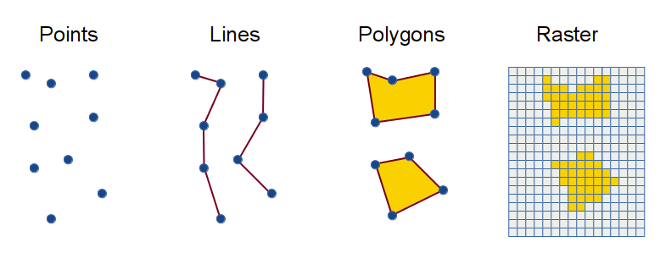
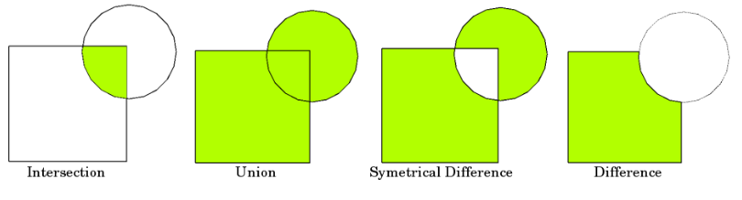
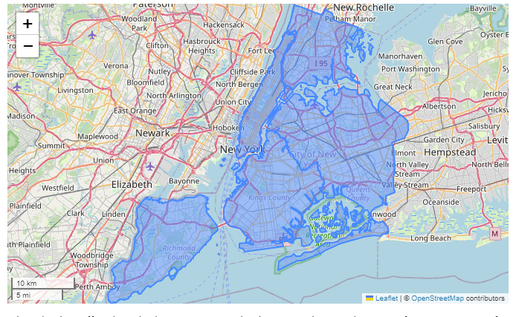
Web maps using the Open Source Spatial Libraries
Spatial Data Structure
Geometric Operation
Interactive map
Open Source
Installing with Anaconda/conda

Slide 41
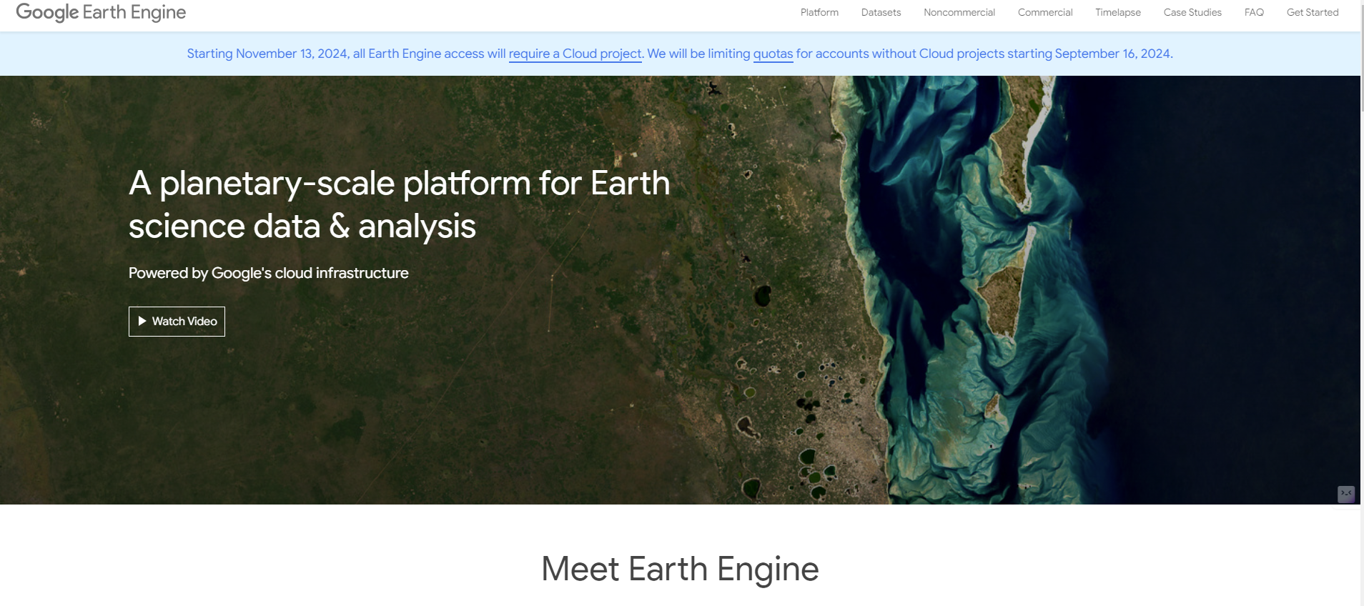
geemap – Google Earth Engine Python API

Slide 42
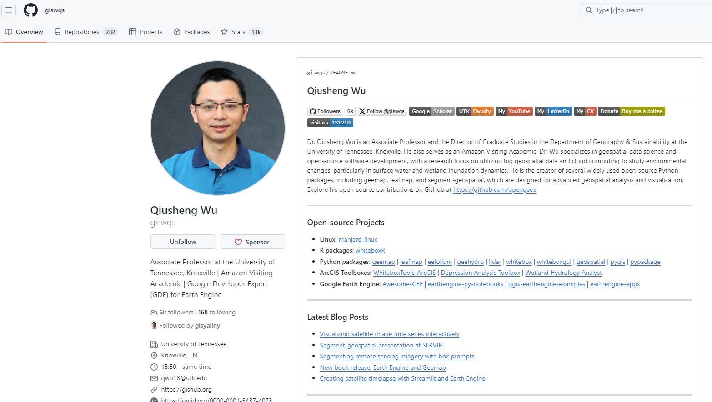
geemap – Google Earth Engine Python API

Slide 43
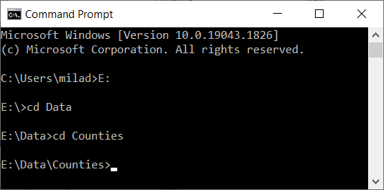
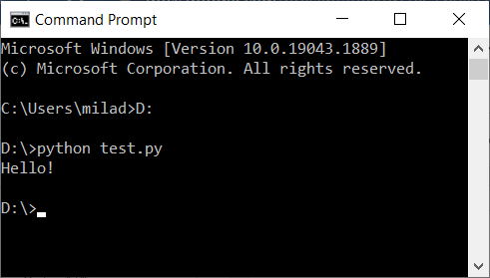
How Do I Program In Python?
Two Main Ways (You should add python to the system variable):
Normal mode (Script Mode)
Write your code in a file (it could be any type of file:txt,word) and save it with the .py extension
Execute the file by using the shell (terminal, CMD, Command Prompt): The picture on the right
You need to direct the shell to where you have the code saved:
If the file (your code) is stored directly in a Drive (in my case it is saved in D drive) you will use the following command: D:
If the file is stored in a nested folder (e.g., “E:\Data\Counties”) then you need to use the cd command: The picture on the left

Slide 44
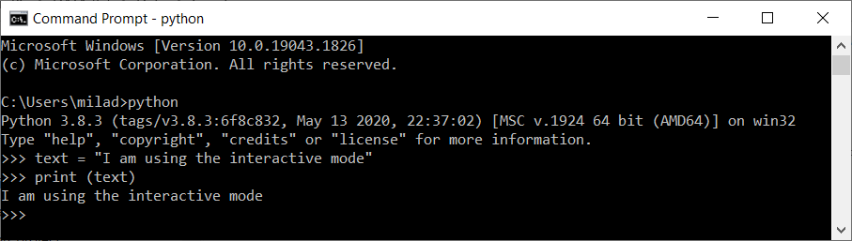
How Do I Program In Python?
The other way:
Interactive mode (interacting directly with the interpreter)
Bring up a terminal (command prompt, shell)
Type python
After the info about the version the cursor will transform to >>>
Start writing your code
After each time you press Enter on your keyboard the command line goes to the next line and if there is something to be executed it will be executed:

Slide 45
Interactive Mode
Start writing in the python interpreter of your chosen python editor.
Pay attention to the indentation
>>> the_world_is_flat = True
>>> if the_world_is_flat:
... print("Be careful not to fall off!")
...
Be careful not to fall off!

Slide 46
Conclusion
Class Schedule
Topics for this course
Command prompt

Slide 47
Next
Install Visual Studio Code
Install Anaconda
Set up environment in VS Code

